Slide 1
Bownce NFT Concept
RECOMMENDATIONS – NFT Initiation phase

Slide 2
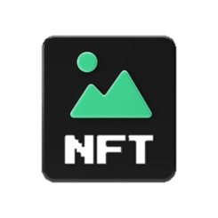
BOWNCE NFT ConCEPT
Bownce can leverage NFT technology to enhance its user experience and ad additional value to the active Bowncer community
Bownce can use NFTs in different contexts. In the following concept we show the possible options and evaluate risk and chances of each approach
NFTs created by Bowncers
NFT earned by Bowncers for achievements
NFTs bought by Bowncers to enhance their profile
Bridging the gap between physical and digital world
Non fungible
Token (NFTs)

Slide 3


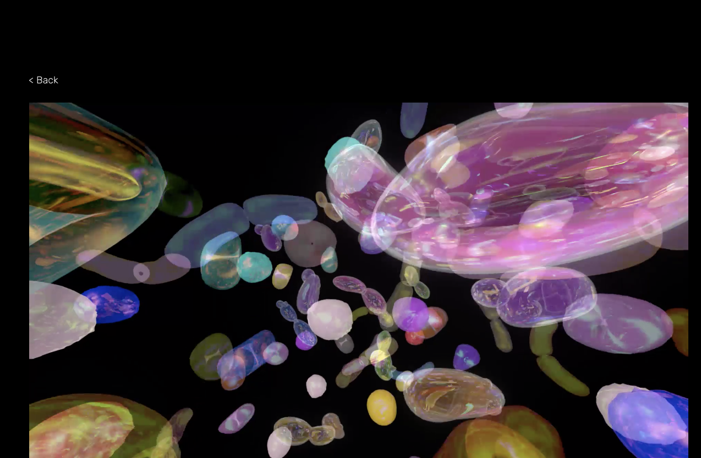
BOWNCE NFT ConCEPT
It is key for Bownce to evaluate future business models based on the NFT technology while providing incentives to the community to join
Your goals:
What we can help you do:
Smart contracts and physical vouchers/wallet
Custom smart contract for standards such as ERC721, mint on sale, whitelisting, fiat payments, crypto payments, and secondary market royalties.
Creating physical wallets or vouchers.
Engaging and motivating the Bownce community
Creating identification for Bowncers with selected sports
Enlarging the Bownce ecosystem with partners from the sports industry (clubs, service providers)
Bringing additional value to Bowncers
Creating a collectible that increases in value
Drive business through ad.ons
Build Bownce NFT marketplace
Custom marketplace based on Tokengate art marketplaces
Customized concepts
Custom branded app for Bownce NFTs with ability for users to connect wallet, mint, and connect directly to secondary markets
www

Slide 4
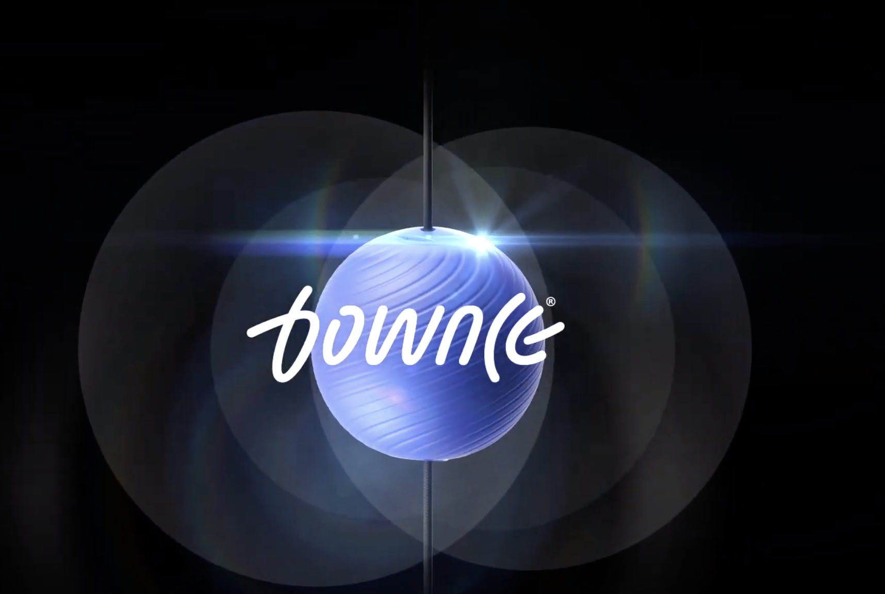



BOWNCE NFT ConCEPT
In order to create an immersive and value-added experience we evaluated four different routes
Overview of possible approaches
Avatar
Sport Legends
Signature
Series
Bownce Your NFT
NFT
Possible Utilities
Badges
Early access
Merchandising

Slide 5
BOWNCE NFT ConCEPT
The four routes of the Bownce NFT concepts address different needs and desires of the Bownce community and ecosystem partners
Route 1 Avatar Appearance and shape of the avatar will be designed based on specific sports (forms, skins, outfits, backgrounds)
Desires and needs of the whole Bownce community
Future revenue streams for the Bownce community, Bownce ecosystem members and Bownce itself
Basis for future business models in the Metaverse based on reliable roadmap
Route 2 Sport Legends
Get limited editions of the legends from your sport, designed by a (well-known) artist
Route 3 Signature Series
Bownce profile created by sport legends, active athletes or team members of a specific club
Route 4 Bownce your NFT
NFTs will be created based on your personal Bownce performance

Slide 6
avatars

Slide 7
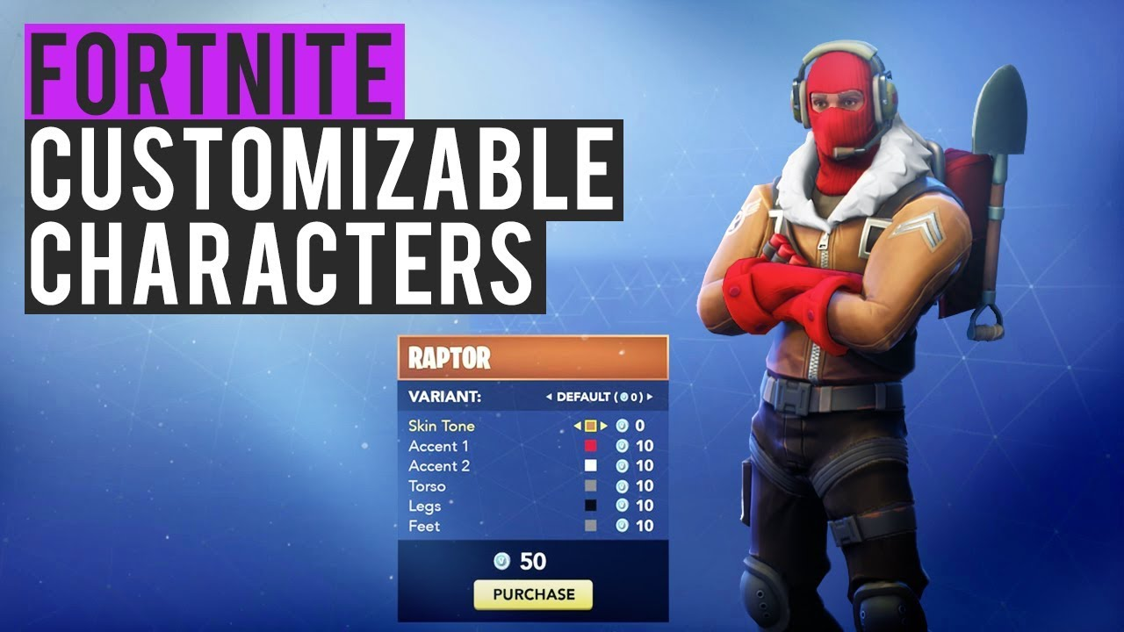
Bownce NFT routes
Avatars
Play or Pay to enhance your avatar
Through playing or paying you can unlock new features for your avatar and your profile
Characters (pay or play)
Skins (pay or play)
Muscles (play)
Outfits (pay or play)
Badges (play
All those items can be trade on the NFT Marketplace
It is fun, enhances your profile and shows your skills
BOWNCE
El BOWNI
© Inacta AG • Bownce Token Economics • CONFIDENTIAL

Slide 8
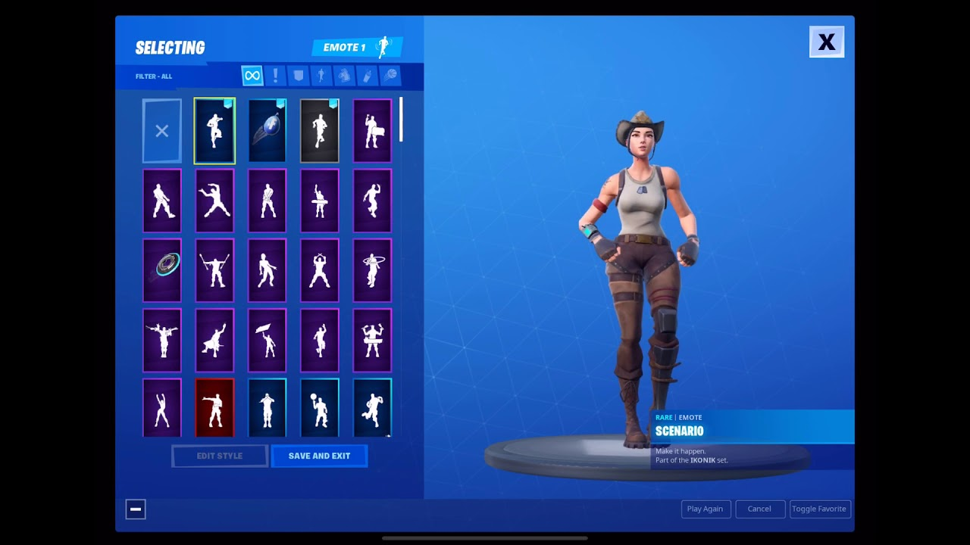
Select Sport
Bownce token ecosystem
ROUTE 1 Avatars
Play or Pay to enhance your avatar
Through playing or paying you can unlock new features for your avatar and your profile
Characters (pay or play
Skins (pay or play)
Muscles (play)
Outfits (pay or play)
Badges (play
All those items can be trade on the NFT Marketplace
BOWNCE
© Inacta AG • Bownce Token Economics • CONFIDENTIAL

Slide 9
Bownce NFT routes
Avatar enhancing is a successful feature already used in various games
Pro
Cons
Fun feature
Works in various games
Established in gaming community
Complex to build
No avatar concept in place
Affinity in target group
Recommendation
Avatars and the possibility to enhance your avatar is a must have in the gaming world. Therefore, we recommend to take it on the Bownce Roadmap.
Integrating NFT solutions will be a further step to take , once the avatar concept is established and working.

Slide 10
Sport legends

Slide 11
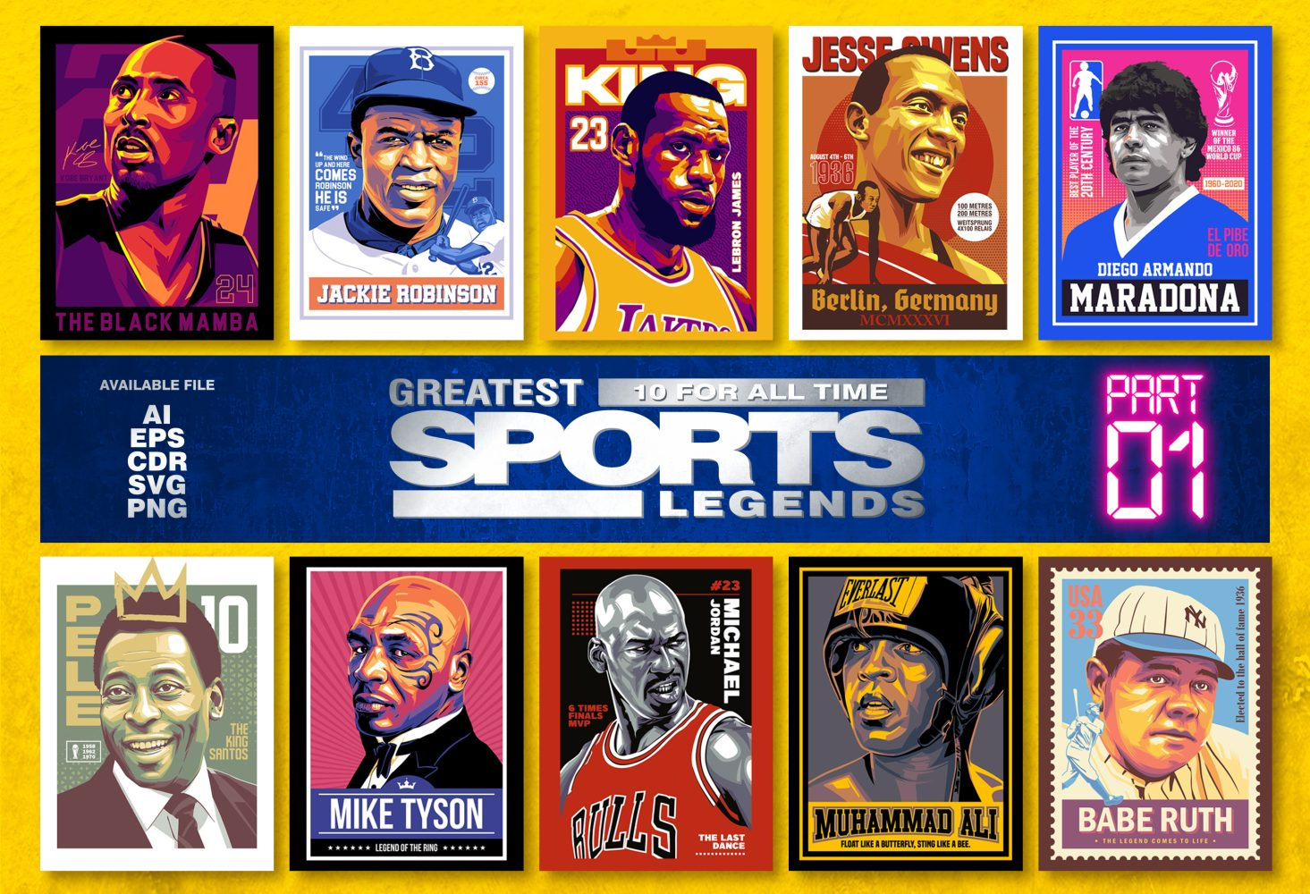
Bownce NFT routes
Sport Legends
Play or Pay to earn NFT
Porfile pictures of Sport Legends
Through playing or paying you can get NFT from different Sport Legends
Soccer
Karate
Kick-Boxing
Etc.
All those items can be traded on the NFT Marketplace (e.g.; elementum.art)
It is fun, enhances your profile and enables collecting and earning
Greatest Sport Legends
Bownce
Limited NFT Series
© Inacta AG • Bownce Token Economics • CONFIDENTIAL

Slide 12
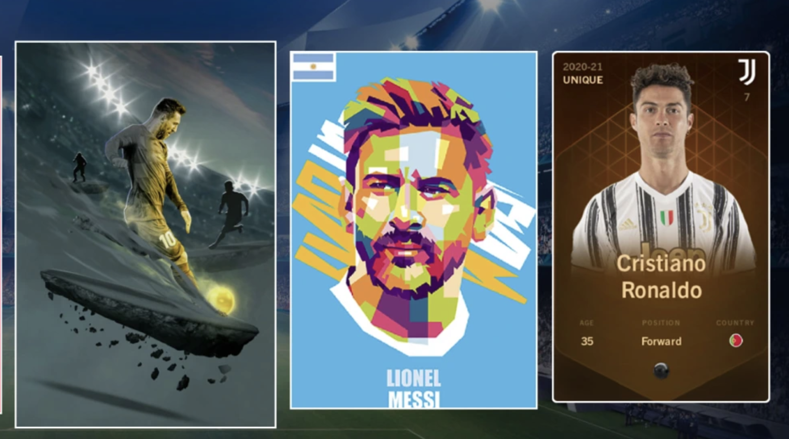
Bownce NFT routes
Benchmarks as inspiration for route two of the Bownce NFT concept
Wraped Strikers
© Inacta AG • Bownce Token Economics • CONFIDENTIAL

Slide 13
Bownce NFT routes
Collecting NFT of Sport Heroes is easy and doesn‘t require complex system integrations
Pro
Cons
Fast and easy to deploy
Potential for trading
Earn and buy options
Different design options
Find Heroes for Bownce
License required
Regulatory requirements to be evaluated and met
Not directly linked to performance
Affinity in target group
Recommendation
Sport legend NFTs have a huge trading potential but might lack the direct connection between physical performance and its digital representation.
We therefore recommend to evaluate this option in a first stage with existing sport legends already having a broad community.

Slide 14
Signature series

Slide 15
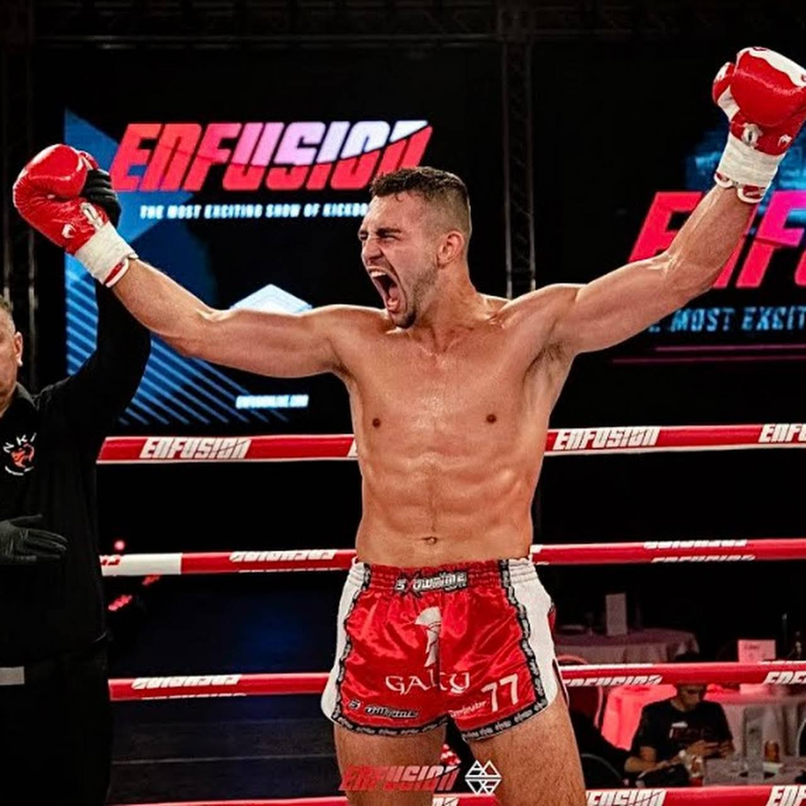
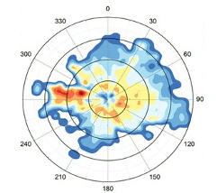
Bownce NFT routes
Signature Series
Play and compete against a hero of your sport.
Compare your Bownce Map with the one of
Sport heroes.
Kick-Boxing: Dominik Santl
Kick-Boxing: Andrii Mezentsev
Soccer: Eintracht Braunschweig players
Soccer: Robert Lewandowski
Soccer: Joschua Kimmich
Karate: Danny Etkin
Karate: Haley Glass
The generated Pictures can be earned or even bought by the Bowncers.
Dominik Santl
© Inacta AG • Bownce Token Economics • CONFIDENTIAL

Slide 16
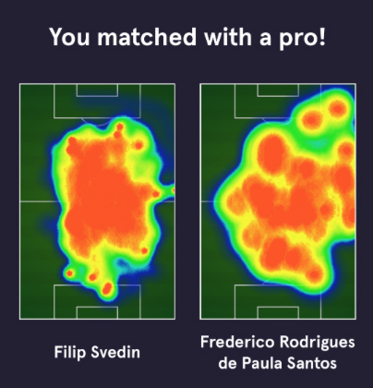
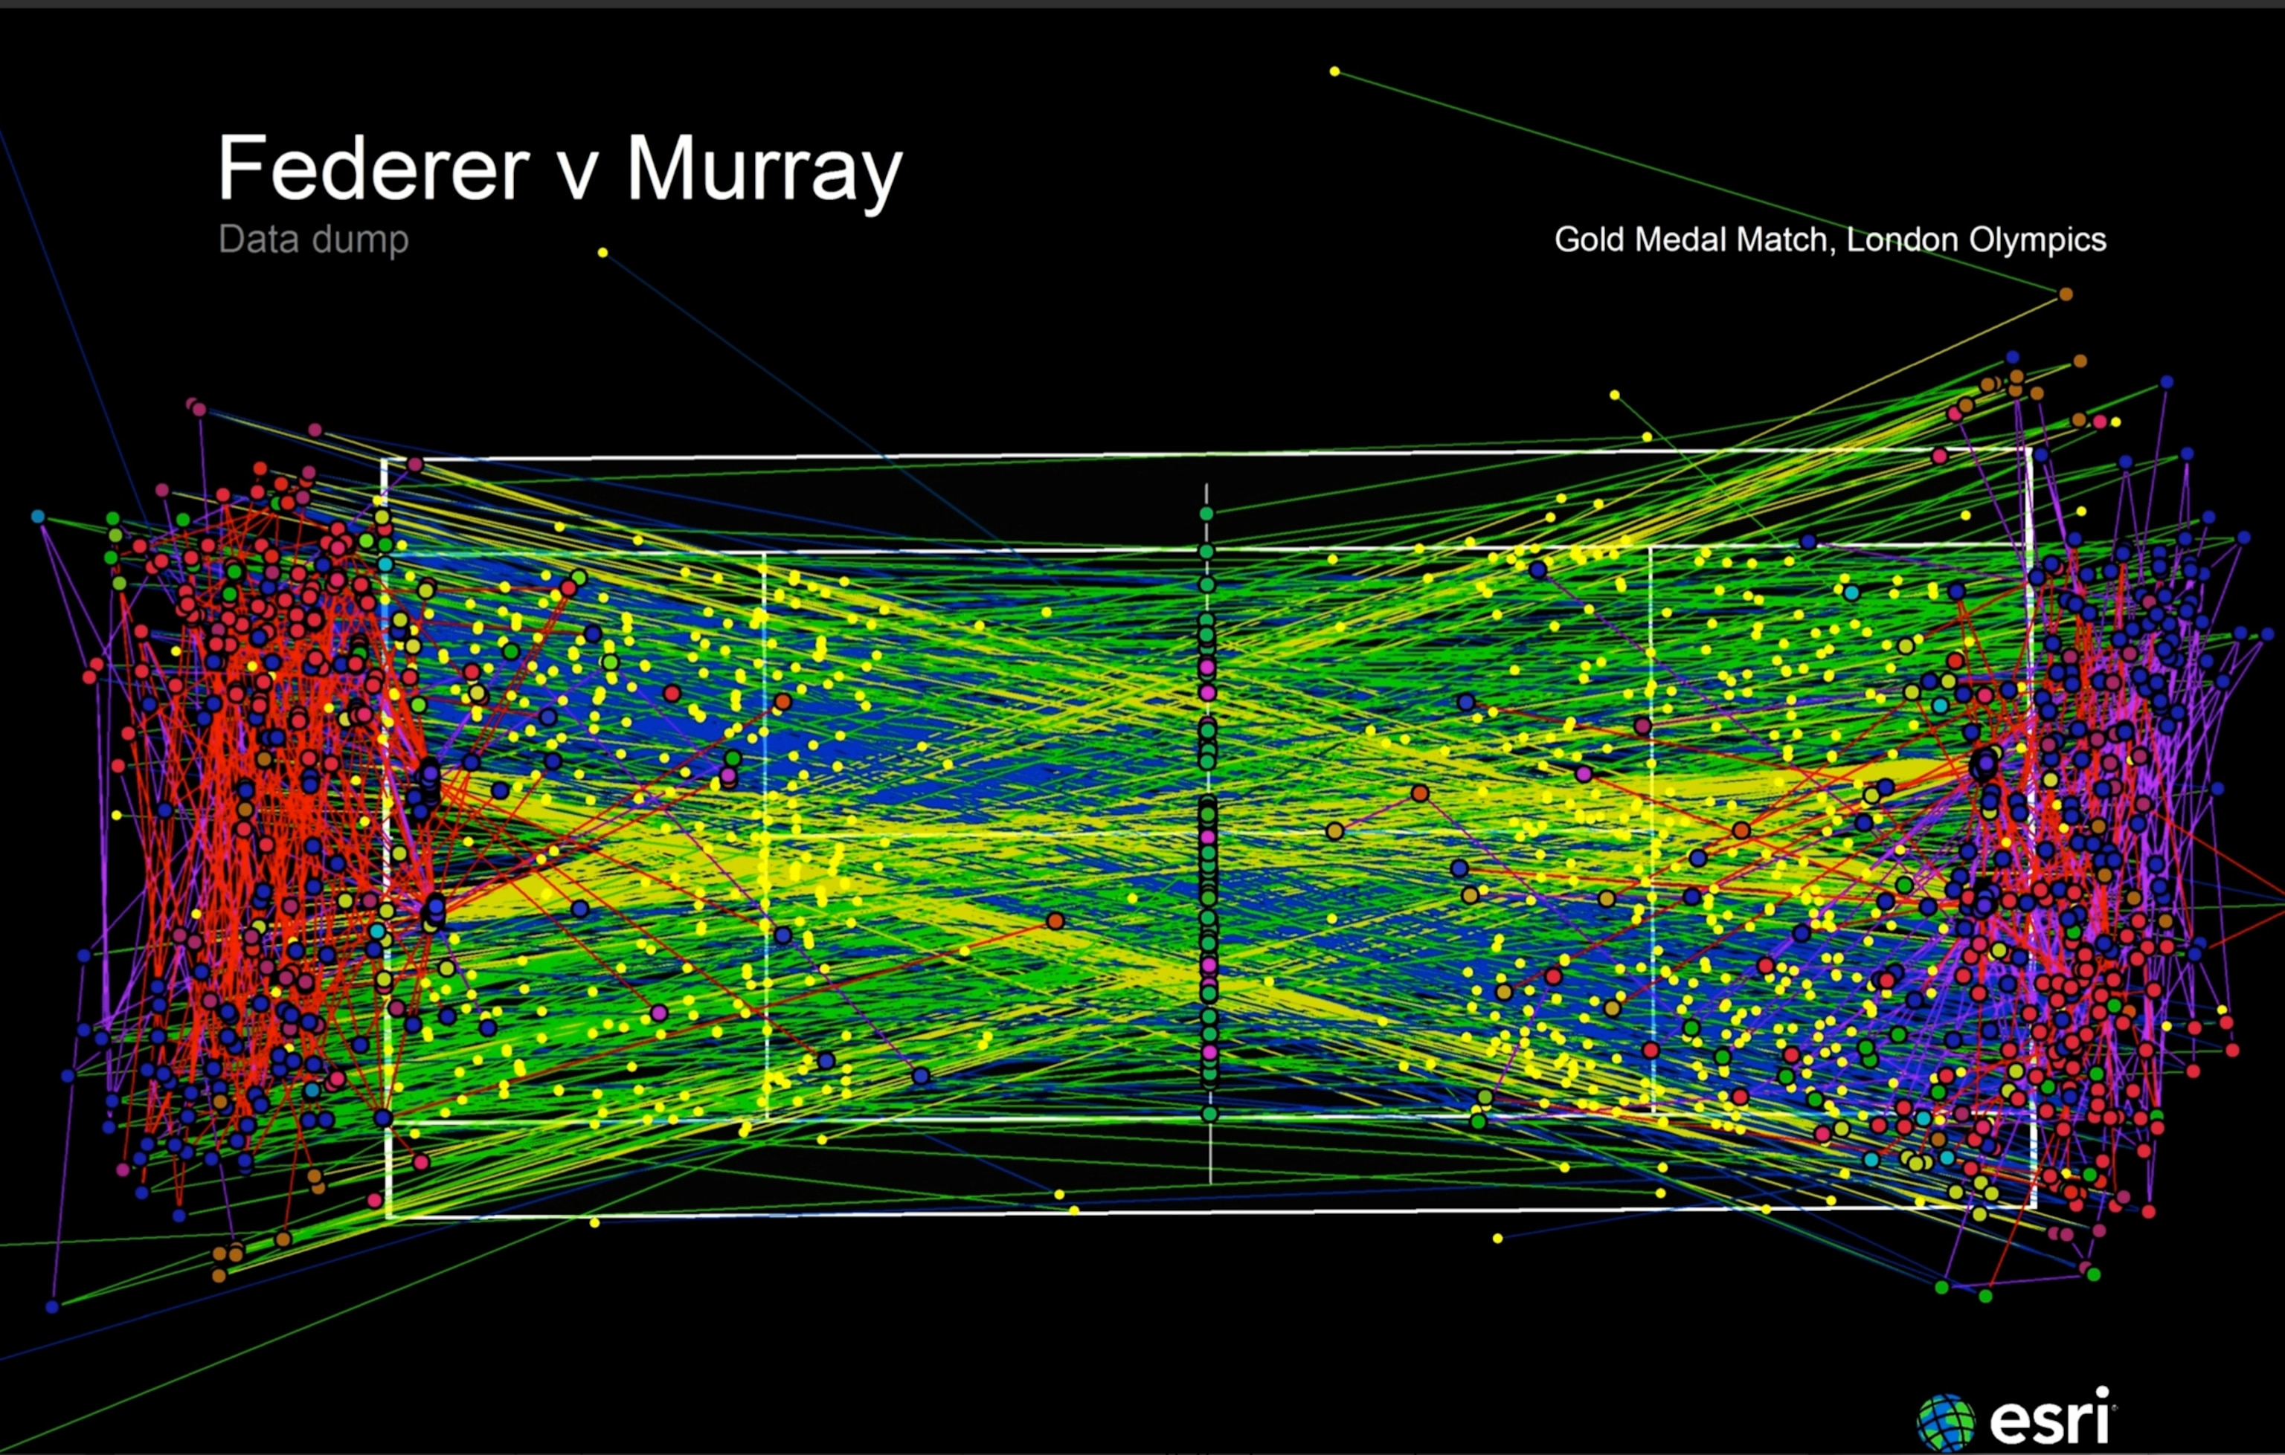
Bownce NFT routes
Benchmarks
No Benchmarks in NFT World
© Inacta AG • Bownce Token Economics • CONFIDENTIAL

Slide 17
Bownce NFT routes
Collecting NFT of Sport Heroes is easy and doesn‘t require complex system integrations
Pro
Cons
Huge fan engagement potential
Motivation for further personal Bownce activity
Potential for trading
Earn and buy options
Different design options
Find Heroes for Bownce
Integration in system
Regulatory requirements to be evaluated and met
Recommendation
Working with heros of sports supported by Bownce is an easy way to promote Bownce and give Bowncers a sustainable added value and access opportunity to their sport heroes.
Limited editions have a huge trading potential and can therefore act as incentives for engaging in further challenges.

Slide 18
Bownce your nft

Slide 19
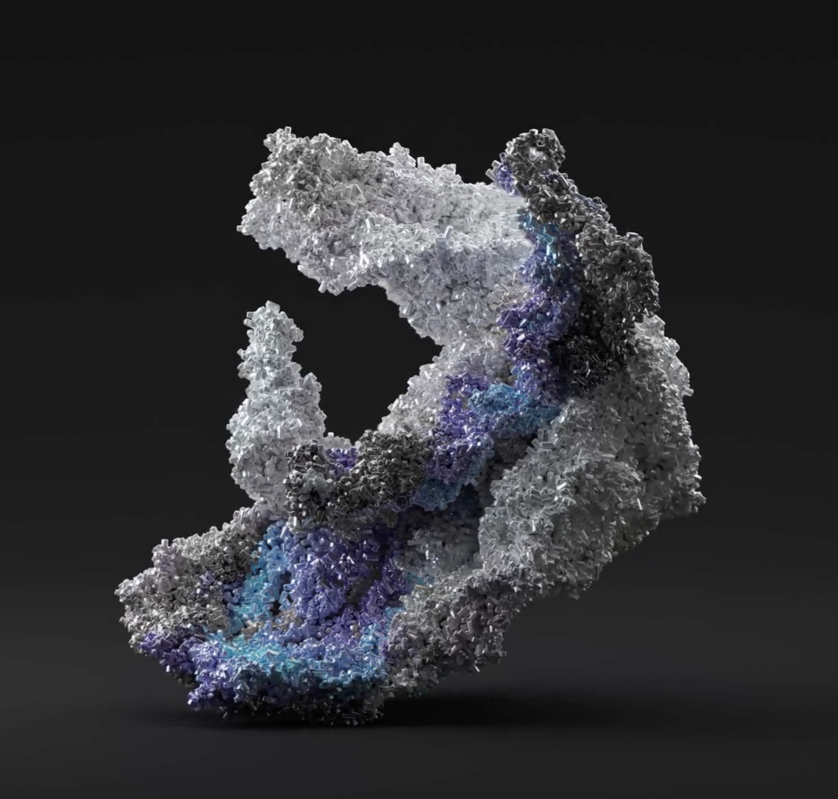
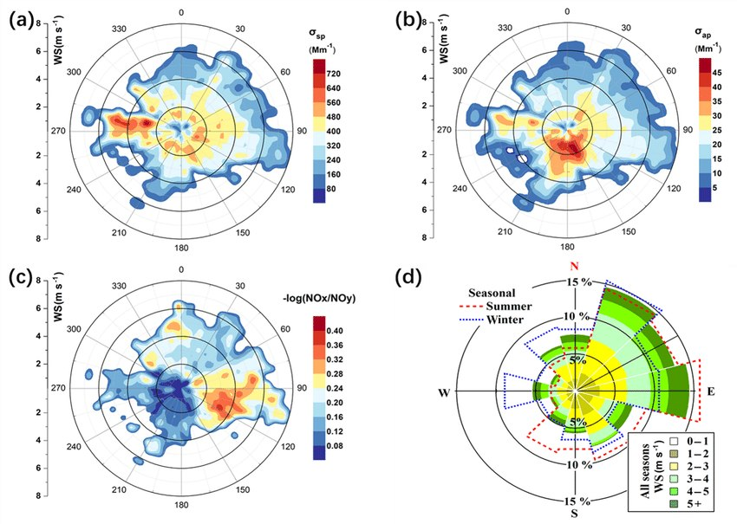

Bownce NFT routes
Bownce Your NFT
Single user device-measurements-based NFT can be created from day one and added as a feature later
Unique patterns of usage of Bownce devices can produce 2D or 3D “art”
Single user NFTs can be combined with images of other Bowncers whose performance is recorded to create motivation and engagement in the community

Slide 20
Bownce NFT routes
Your personal Bownce NFT motivates you to improve and present your performance to other community members
Pro
Cons
Personalized user experience
Easy to understand concept
Benchmark to improve your performance
Easy to deploy based on collected data in Bownce device
Lower trading potential
User experience decreases over time
Community interest needs to be stipulated based on e.g.; best in class or best performance of the months NFTs
Recommendation
Bownce your NFT is an easy-to-understand concept which can be deployed on existing data at low cost. From the user's perspective, there are few extensions to the concept to motivate Bowncers to generate more NFTs besides the personal performance improvement

Slide 21
NFT Utilities

Slide 22
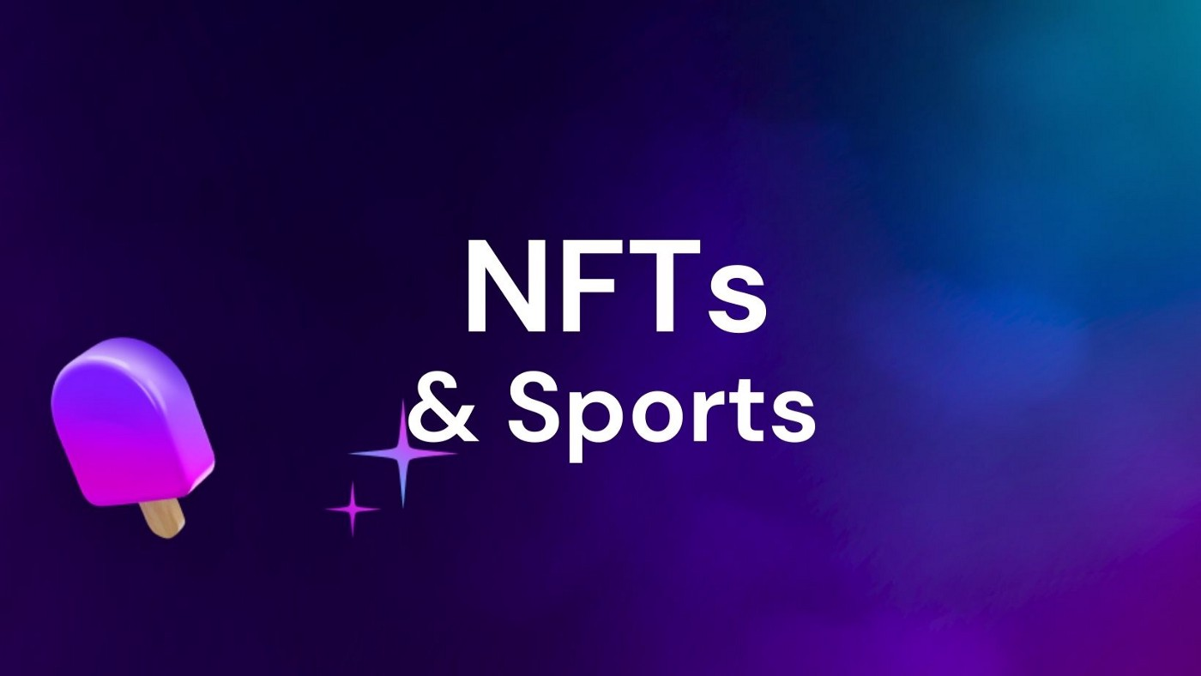
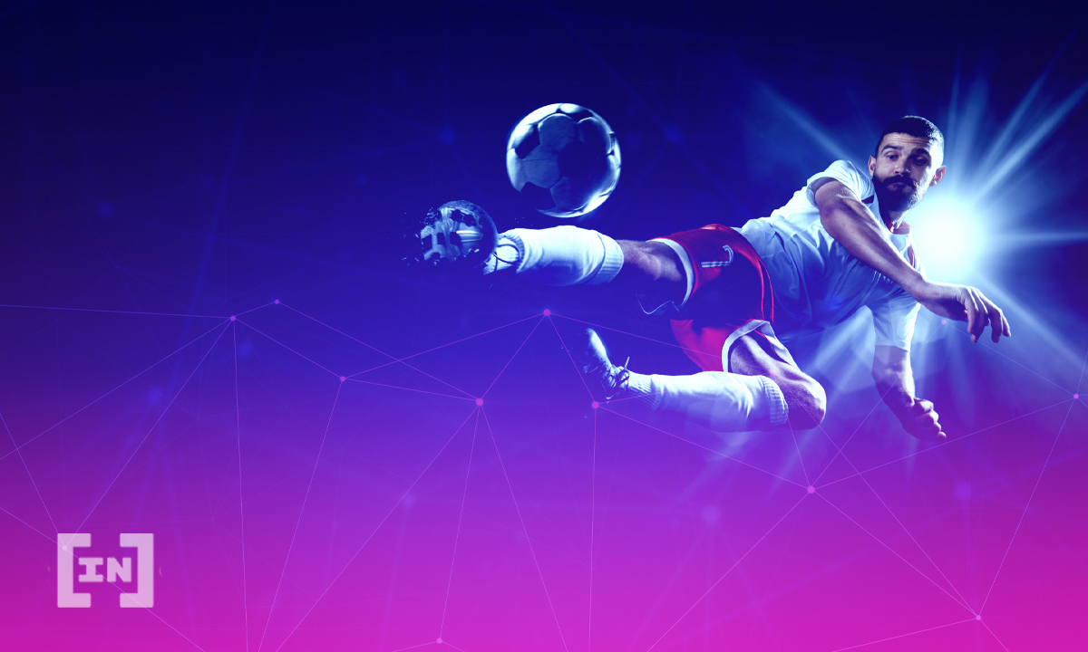
NFT utilities
Engagement Concept
Utilities can be enriched based on the needs of ecosystem partners and sport specific accommodations in the fields of fan engagement, merchandising, VIP-treatment, etc.
Early Access
Meet and Greet
Sweep Stake
Whitelisting for special Drops
Access to limited Merchandising
And many more options…

Slide 23
Token Flows
Illustration of NFT Creation (Proposal for Stage Two/Three) options
NFT Creation 1:
NFT Creation 3:
Bowncer
Bownce "Daily Auto" Wallet
Bowncer
Single set of exercise creates the NFT based on performance.
If created by an influencer or famous sportsperson, can be quite valuable. "Ordinary" users can (should be inspired to) become influencers over time.
Fees paid by users in BBT.
Bownce issues NFTs to Bowncers to reward them for their regular activity and/or achievements.
Fees paid by Bownce.
NFT Creation 2:
NFT Creation 4:
Bowncer
Bowncer
Challenge Smart Contract
Bowncer
Bowncer
Multiple Bowncers can create an NFT jointly, through activity (not competition) Fees paid by users in BBT.
Challenge winners get NFTs to mark their achievements. Various "levels", according to the level/stage of the competition.
Fees paid from the users' challenge fees in BBT.

Slide 24
Outlook

Slide 25
outlook
Overview of the next steps planned to start the journey in the Metaverse
1
Agree on envisioned roadmap
Agree on the scope of the future NFT use cases to outline the envisioned roadmap
2
Plan implementation of prio 1 route
Start the envisioned roadmap with the implementation of one prioritized route to achieve tangible results till the end of 2022
NFT
3
Artwork & Community Building
Based on the envisioned roadmap and the prioritized route, evaluate and select artist and artwork combining the Bownce vision with future NFT and Metaverse design elements to build up a community upon

Slide 26
outlook
Envisioned Road – Initial Draft based on Inacta Experience without having a detailed requirements catalogue in place
*
Needed Functions
Q4 2022
Q1 2023
Q3/Q4 2023
UX/UI
Level of involvement and needed capacity per function depend on requirements per NFT route and timeline of implementation
BOWNCE
Marketing/ Community Mgmt.
Design/Art
Estimated Cost
Smart Contract Development
170k – contractually agreed
INACTA
Business Modelling
30k – budget needed
* Bownce your NFT route as precondition for Signature Series route

Slide 27
Outlook
Timeline and Deliverables
2022
JUN | JUL | AUG | SEP | OCT | NOV | DEC | →
Project Kick-Off
Product Roadmap
Go-Live
20.07.
Q4
Roadmap
Workshop
Define and outline NFT roadmap
Implementation of other routes based on the envisioned and prioritized roadmap
Implementation of 1 route
Implementation
Desk-top research regarding
Features
Market adoption
Customer survey evaluation
Recommendation
Market Entrance Phases
Testing & Integration
Release & Deployment
Artwork & Community
Go-to-market
Art/Artwork
Community Building – Curation

